Slide 1

Mobile Testing Tools
www.pragmatic.bg
Lector: Dimitar Topuzov
E-mail: dtopuzov@gmail.com
LinkedIn: http://bg.linkedin.com/pub/dimitar-topuzov/18/470/833/en
Copyright © Pragmatic LLC 2018

Slide 2
Content
Evaluating mobile test automation tools
Automation strategies
Review of most popular automation tools
Other tools
Local labs vs. Cloud Platforms

Slide 3
Criteria
Ease of script development and execution
Writing, maintaining and running scripts should be easy
Some recorder based tools with save time for creating tests, but if recorder is not smart enough (do not generate page objects under the hood) maintenance might be nightmare.
Always have in mind command-line execution. CI servers does not use IDEs and can’t click green “run” buttons.

Slide 4
Criteria
Cross team collaboration capabilities
Both QA and Devs can easily contribute to testing
Even if Devs do not contribute for testing, live is much better if Devs can easily run functional tests (usually written by QAs) before commit.

Slide 5
Criteria
Cross team collaboration capabilities
Match between dev and test languages/ecosystems
iOS development is usually possible only on Apple hardware and OSX. It is not good idea to select test automation tools automating iOS phones trough Windows OS.
Best case is to have development and testing writing the products and tests on the same language (or at least ecosystem)

Slide 6
Criteria
Support for different mobile OSs
Cross-platform tools boost productivity significantly
With cross-platform tools you can have a single code base
With single code base you need single way to do reporting and CI/CD integrations

Slide 7
Criteria
Support for both devices and emulators/simulators
Real devices are expensive and can not scale easy
0% of end users use emulators and simulators
Be careful for this:
iOS Simulator runs only on macOS.
Some vendors provide solutions that allow you to test on iPhone attached to Windows PC.
This sounds great, but what if the tool is Windows based and can not run on macOS -> you can not test on iOS Simulators -> you can not scale ☺

Slide 8
Criteria
Speed of releasing support for new mobile OSs
iOS devices are updated to latest OS very fast
Usually new iOS versions became the most used once in less then 2 months
You do not need a tool that supports latest version of iOS 3 months after it is released

Slide 9
Criteria
Community support
It is always better to pick up a tool/framework with active community and development
If it is not widely adopted -> this is not your tool
If you see that latest commit is before 6m -> this is not you tool
If commits are from the same author -> think about buss factor

Slide 10
Criteria
App Instrumentation
A lot (actually most) of the tools require app under test to be instrumented in order to be tested.

Slide 11
Criteria
App Instrumentation
Disadvantages
What you test with automated tests in not what you release
You can not implement Continuous Delivery
You can automated only our app, because native apps are not instrumented
What will happen if a button in your app open native calendar of the OS?
Instrumentation itself might not be easy via command-line
You need to spend extra effort just to make the app testable

Slide 12
Criteria
App Instrumentation
Advantages
No dependency on native automation APIs
Usually leads to faster tests
Usually give more control in context of app under test

Slide 13
Automation Approaches and Tools
www.pragmatic.bg

Slide 14
Approaches
Platform’s build-in testing tools
Each platforms comes with its own build-in tools
That is actually how manufacturer of the OS test its own apps
Usually build-in tooling are based on accessibility APIs
Usually build-in tooling does not require instrumentation
Usually use the language used for developing the app
Note that language is different for each platform
=> No cross-platform testing with single tool.

Slide 15
Approaches
Tools based on platform’s build-in solutions
Some guys think build-in tools are not good enough and try to make them better, result is tools that usually:
Expose better API
Provide some extra features
Make possible usage of build-in tools from other languages
Those tools have all the bugs of build-in tools (and some more)

Slide 16
Approaches
Tools based on instrumentation of app under test
This approach add some additional lib in app under test
Automated tests talk with something which live in app under test
App under test is not the same app you release
This is a blocker for implementation of Continuous Delivery
Bypass platform limitations
Apple Instruments had 1 second delay between each two calls
Can not use the same UI tree explorers as build-in tools
visual tree != accessibility automation tree

Slide 17
Approaches
Tools based on images
Technology agnostic
Good for testing games or apps without accessibility
Hard to scale, high maintenance if UI changes a lot
You need different images for each device you test because of different resolutions and different rendering in different OSs
You need to change the pictures after each change in the UI

Slide 18
Platform Build-In Tools
Android
UI Automator
UI Automator is a UI testing framework suitable for cross-app functional UI testing across system and installed apps.
Espresso
Espresso’s full power is unlocked by those who are familiar with the codebase under test.
Recorder is available in Android Studio 2.2

Slide 19
Platform Build-In Tools
iOS
UIAutomation (for iOS up to version 9)
Deprecated with iOS10/Xcode8
XCTest (for iOS 9 and above)
Available with Xcode 7+ for iOS9+
Recorder is available

Slide 20
Based on Build-In Tools
iOS
Keep It Functional (KIF)
Frank
Android
Selendroid
Cross-platform
Appium
Calabash

Slide 21
Based on Instrumentation
Smartbear Test Complete (Mobile)
Telerik TestStudio (Mobile)
Most of the enterprise level tools

Slide 22
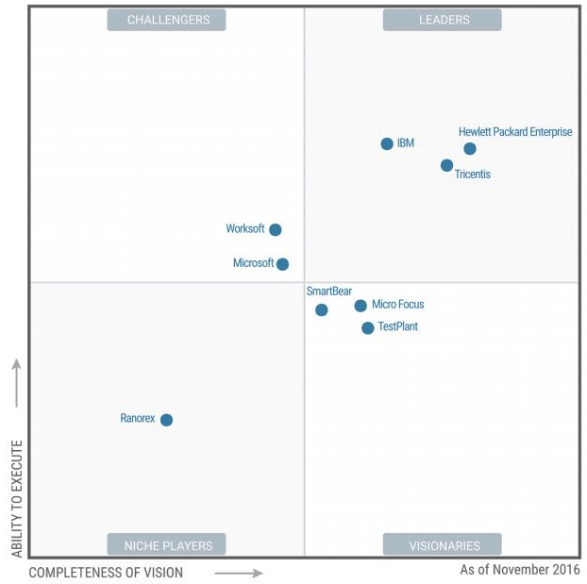
Enterprise Tools - 2016

Slide 23

Enterprise Tools - 2017

Slide 24
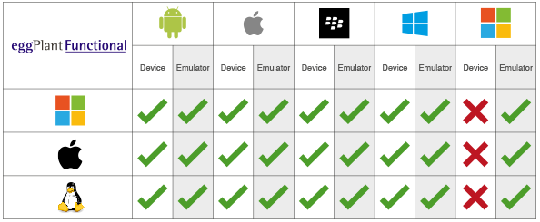
Tools Based on Images
Sikuli
Free, but can not test on real devices out-of-the-box
eggPlant
Most of the enterprise level tools support images based testing as feature

Slide 25
Open Source Tools
Recently article became popular:
https://fossbytes.com/5-open-source-mobile-test-automation-tools
Appium – Great
Robotium – Don’t spend time on it!
Free framework, paid recording
…while there is already official free recording by Android Studio
Only for Android, will die soon (according to me)

Slide 26
Open Source Tools
Selendroid – Don’t spend time on it!
Something like appium, but only for Android
No single plus compared to appium -> will die soon
Keep It Functional – Don’t spend time on it
Only for iOS, can write tests only on Objective C/Swift
Modify app under test
Apple already have good recorder n Xcode -> KIF will die
Monkeytalk – Don’t spend time on it
Accrued by Oracle on August 6, 2015
Defacto it is already dead (11 start on GitHub)

Slide 27
Mobile Automation The Big Picture
www.pragmatic.bg

Slide 28
The Big Picture
To automated in mobile world you will need:
Automated emulator/simulator management
Automated management of test machines and tools
Automated tests
CI (automated execution of automated tests)
Reporting

Slide 29
Device Management
Create and delete emulators and simulators
Create emulator/simulator with required OS version, screen size, hardware and settings
Reset state of emulator/simulator
Delete unused emulators/simulators to clean space
Change settings of emulators and simulators
For example: set different geo location
Install and uninstall applications
Install app under test
Uninstall older apps (with or without cleanup user data)

Slide 30
Machines Management
Management of test machines and tools
In order to use latest mobile OS versions in emulators/simulators or to work with latest physical devices you need latest versions of Android SDK or Xcode
Most of the tools you need for automation have frequent releases and you need fast way to get latest version on all machines

Slide 31
Automated Tests
Automated tests
We already did review of approaches and tools
Pick one of them and write tests ☺

Slide 32
Continuous Integration
Continuous Integrations will help you to
Execute your tests when you are not at office
Execute test exactly when change is committed
This helps to have fast feedback
Fast feedback is VERY important!
Better watch this video
Uncle Mitko principal:
Automated tests not on CI are not automated tests

Slide 33
Reporting
How developers understand something is broken?
You investigate and tell them?
Not an option! It does not work if you are on vacation.
Send them email?
A bit better, but who read emails when he is busy to write code?
It might be too much spam.
Dashboards?
It is visible for everyone in the room, no spam.
Return back status on PRs?
The most working solution for us.
No spam for other devs, no one merge PR if it is red ☺

Slide 34
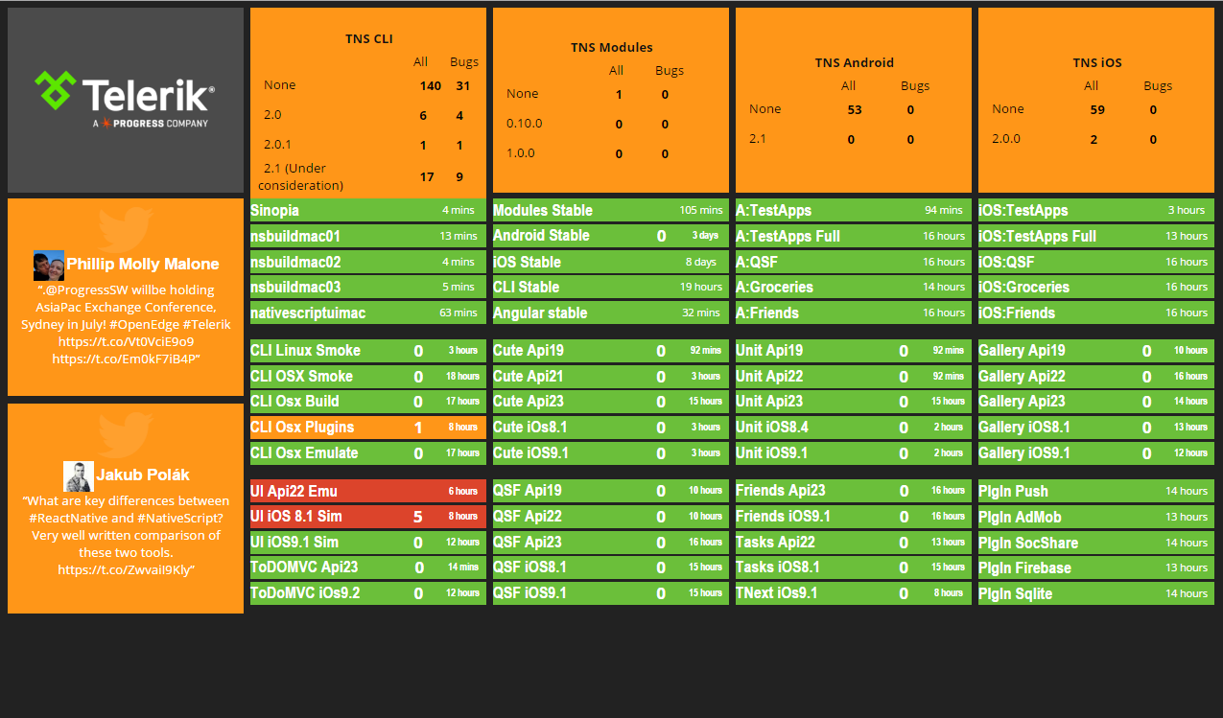
Reporting

Slide 35
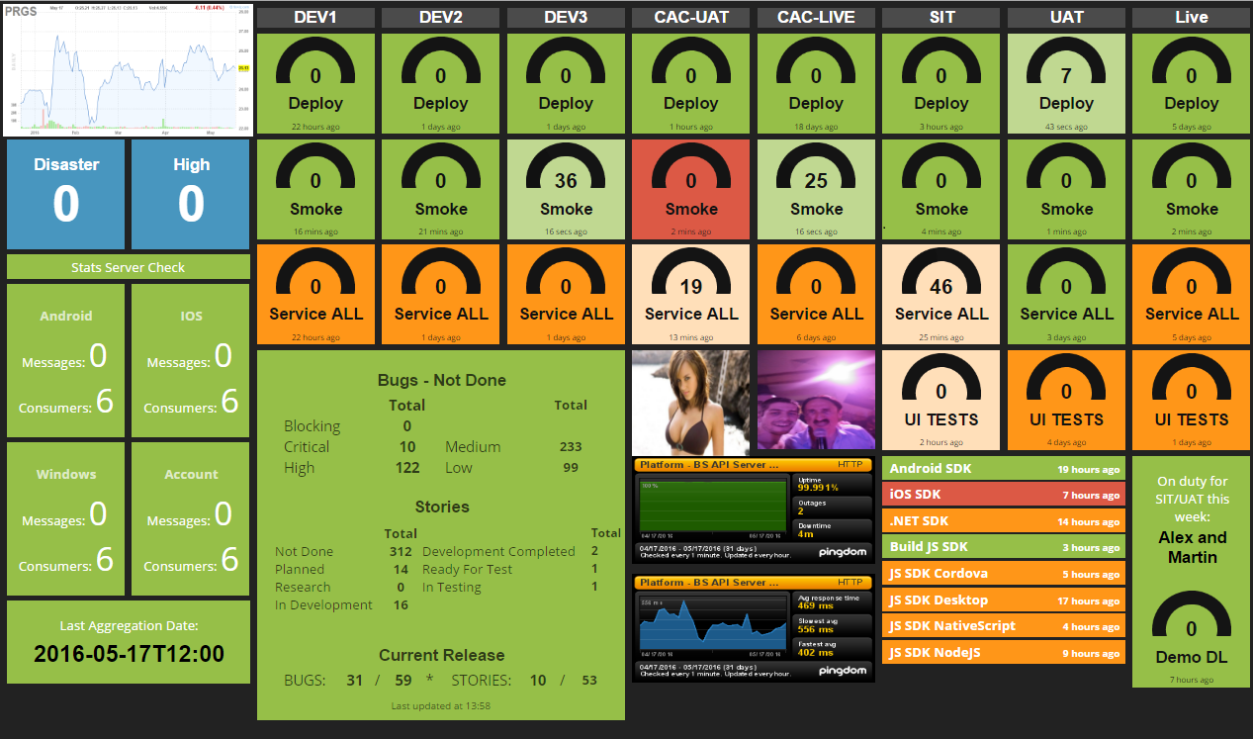
Reporting

Slide 36
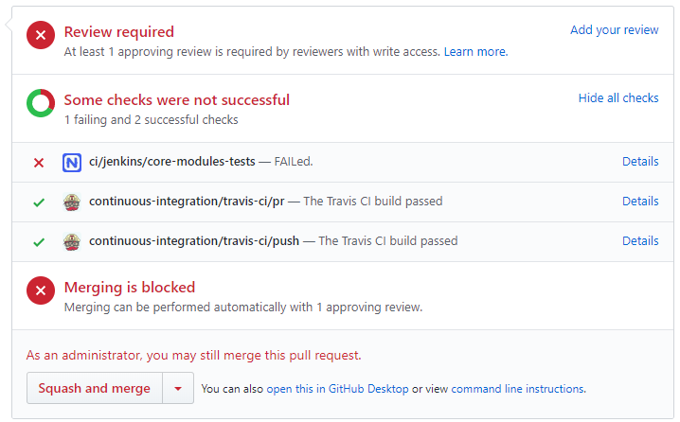
Reporting

Slide 37
Other Tools
www.pragmatic.bg

Slide 38
Other Tools
Chrome Dev Tools (Device Mode)
Google Mobile Friendly Websites
droid-at-screen
OpenSTF
Fastlane

Slide 39
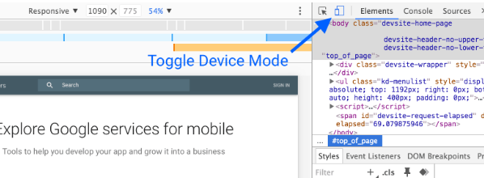
Chrome Dev Tools
Chrome Dev Tools -> Device Mode
Simulate web on mobile devices

Slide 40
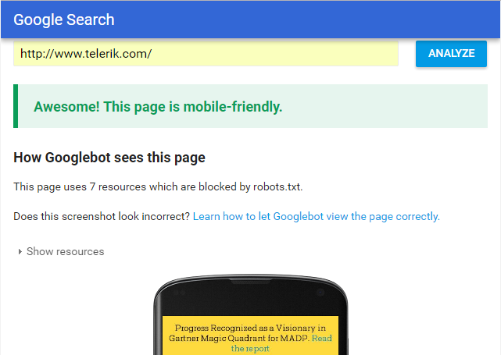
Other Tools
Google Mobile Friendly Websites
Analyses your website and check if it keeps to recommendations for mobile design

Slide 41
Android on Desktop
droid-at-screen
Show the screen of an Android device on a computer
Useful for presentations
Two-way communication
Click on projected screen will click on device

Slide 42
Manage Local Devices
OpenSTF
Control and manage real android devices from browser
Keyboard & Mouse Input
Copy & Paste to and from the device
Take Screenshots
Drag & Drop APK files
Display Logs with real-time filtering
Run Shell Commands without leaving your browser
See it in action

Slide 43
Manage App Release
Fastlane
Snapshot
Taking localized screenshots of iOS apps on every device
Deliver
Upload screenshots, metadata and your app to the App Store
Pilot
Manage TestFlight testers and builds from terminal
Screengrab
Automate taking localized screenshots of Android apps

Slide 44
Local Labs vs. Device Clouds
www.pragmatic.bg

Slide 45
Testing in the Clouds
Pros
Test on large range of devices and OS versions
Save time and resources from local lab management
If you have local device lab you need to buy devices, take care for OS updates, power management and so on…
Most of device clouds provide nice logs and artefacts out-of-the-box (screenshots and or even perf data)
Device console log, screenshots, videos

Slide 46
Testing in the Clouds
Cons
Very expensive to run on each commit
Some vendors might have custom or appium server, or at least different version of appium server
Bugs in their software
Acquired by another company and then shutdown

Slide 47
Testing in the Clouds
Cons
Devices are not physically available
You can not get the device and give it do devs to debug
You can not get the device and take picture with its cammera, test gps or accelerometer
Speed of support for new devices/OS versions
Sometimes support of new OS versions happens several months after official release (which might be critical)

Slide 48
Testing in the Clouds
Popular device clouds
Sauce Labs (recently acquired Test Object)
Amazon Test Cloud (was Appthwack)
Google Test Lab (was Appurify)
Browserstack
Testdroid
Perfecto Mobile

Slide 49
Popular Device Clouds
BrowserStack
Very popular for web, but also supports native mobile apps
Big delay introducing iOS 10 in the past
Currently runs only appium@1.7.0 as server
iOS devices with maximum 11.0 (while we have 11.3 now)
Latest supported Android is 8.0 (while 8.1 is available)
Free plans for open soruce!

Slide 50
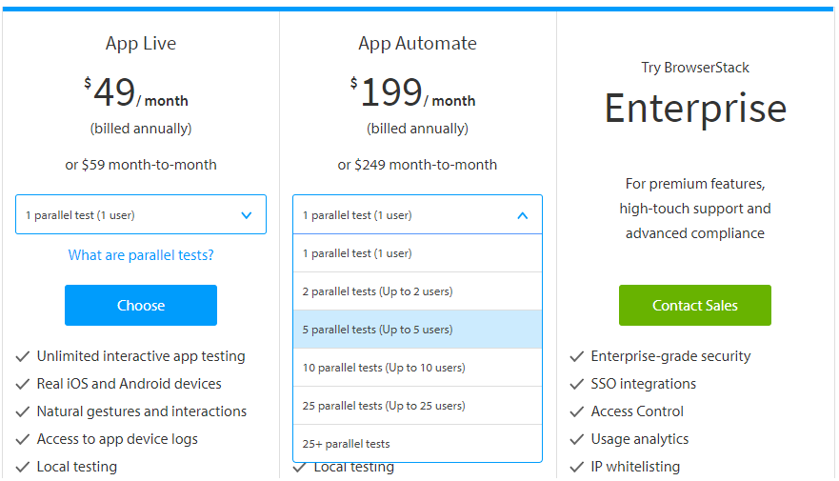
BrowserStack Pricing

Slide 51

Testing in the Clouds
Calculate based on your goals and project
Take in to account risks (new OS versions support)

Slide 52
Local Labs
www.pragmatic.bg

Slide 53
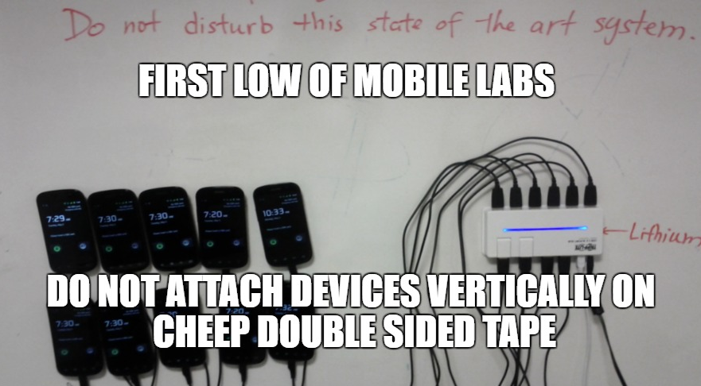

Slide 54
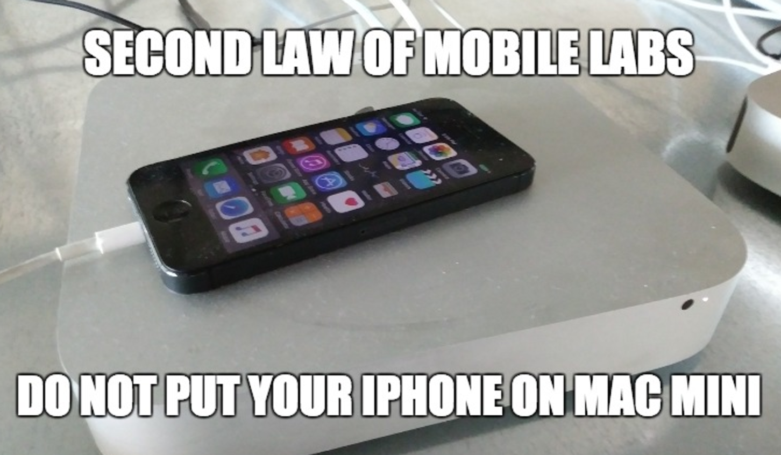

Slide 55
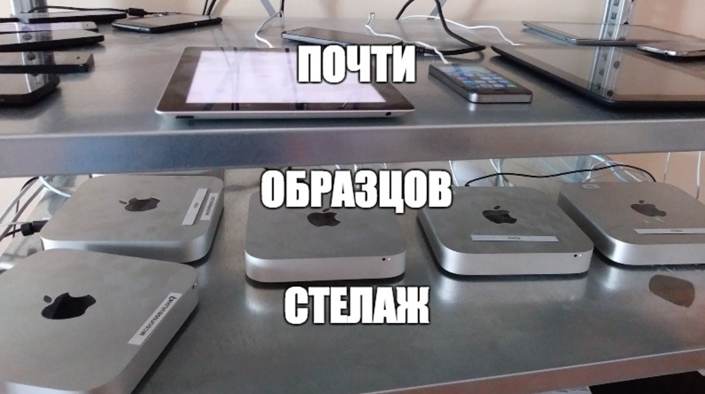

Slide 56
Local Device Labs
Advantages
Full control
You have control on both host machine and device
Can test as early as possible
Even with beta version of new OS
Speed
Clouds usually use VMs, on VMs you can not run accelerated emulators.
Local labs can give you much better performance.

Slide 57
Local Device Labs
Disadvantages
Initial costs and time for initial setup
Device and machines costs
Hard for maintenance, need to invest a lot in:
Automated machine setup and update
Emulator/Simulator management
Create/Delete/Reset and detect not responding emulators/simulators.
Keeping info for emulator/simulator state -> Is it used by other job.

Slide 58
Local Labs
Possible approaches
One very powerful machines with a lot of devices attached on it
Many low-end machines with lower number of devices
VMs with forwarded USB ports
VMs are not an option for accelerated emulators!

Slide 59
Parallel Execution
Parallel Emulators
Possible, can run as many emulators as RAM you have
Usually emulators use ~1GB RAM
Parallel iOS Simulators
Possible since Xcode 9
Tips:
You may need to increase limits for open files and processes.

Slide 60
Parallel Execution
What you want from your automation?
Selenium Grid to split tests in suite on several devices
In theory it is possible
Please take in to account:
Selenium Grid and Emulator/Simulator stability
Can not run several instances of one native app on the same device
If you need to parallelize tests for same app you will need a lot of devices of the same type.
May be it will be better not to parallelize on same, but test on different.

Slide 61
Parallel Execution
What you want from your automation?
Something like saikrishna321/AppiumTestDistribution
This solution start multiple emulators and run tests on them
What actually you have:
Hard to start a lot of emulators on one machines at the same time
You have one mega job that return pass/fail summarized for 10 emulators
What if one of them fails and 9 are OK -> You need to open some report, drill-down, navigate and eventually find it
Over engineered from architectural point of view -> you need to run multiple threads, merge tests results and reports

Slide 62
Parallel Execution
How you can do it:
One job run against one emulator/device/simulator
If you have 10 jobs and one fail you will know that this is a bug exactly on this device
No need to drill-down, no over engineered architectures
Optional:
To optimize the speed you can implement automation that keeps emulators open between jobs. This will save emulator boot which is slow operation.

Slide 63

Questions

